Slide 1
Cyberquack MDR Solution
Logan Johnston, Dallas Nuedorf, Paolo Penaflor

Slide 2
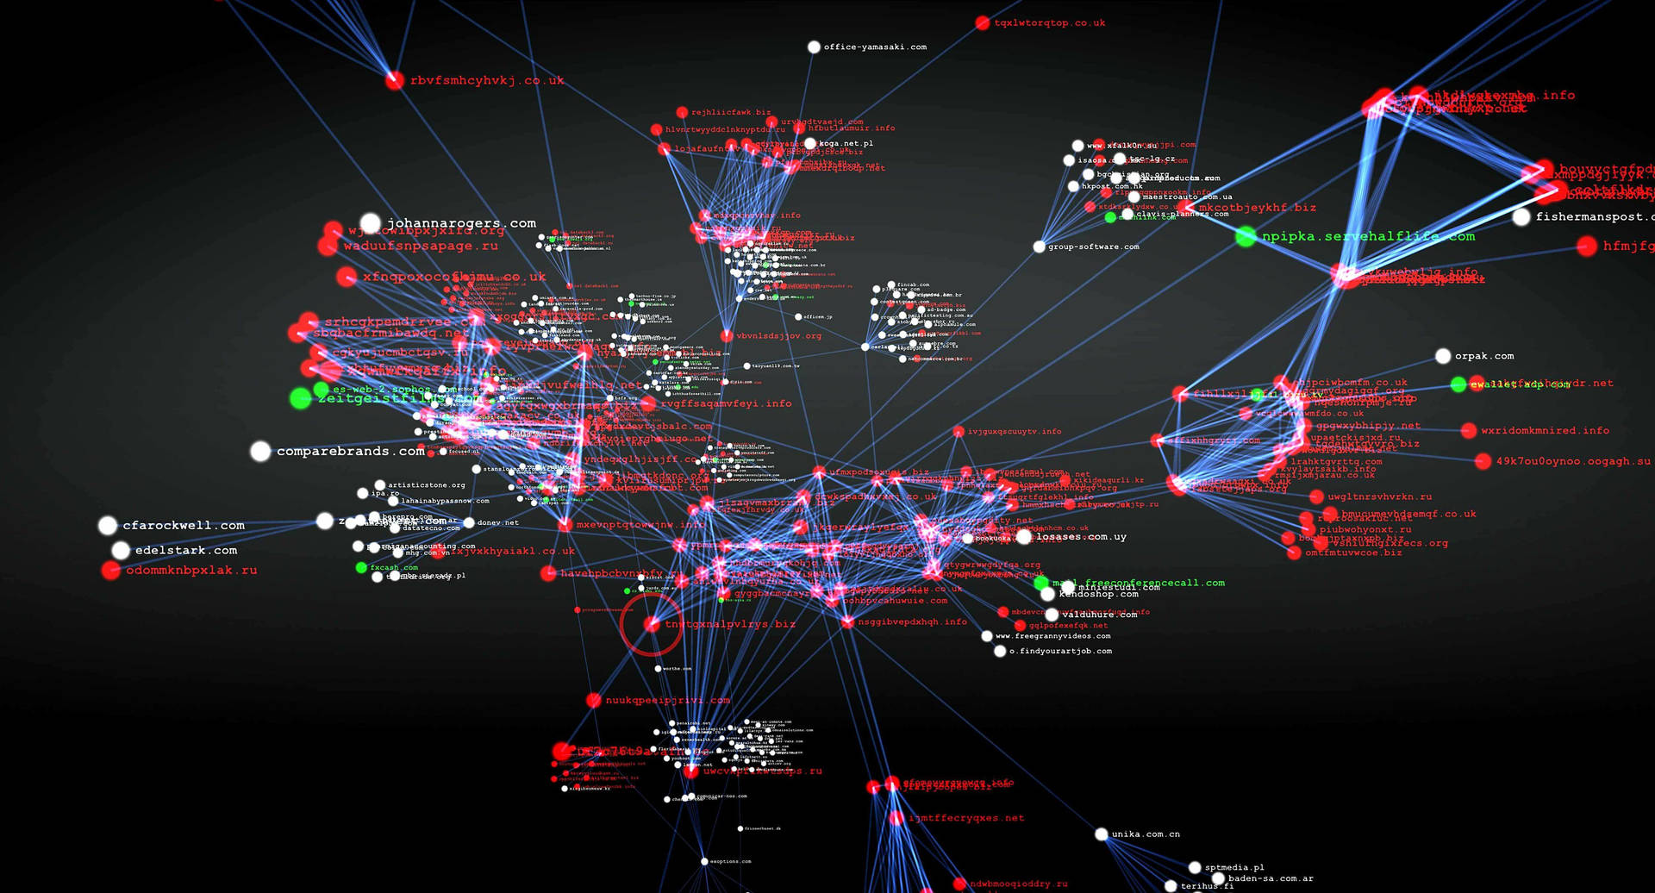
90% of Municipal networks can be accessed without consent…

Slide 3
ABOUT US
Since 1994, CyberQuack has been an industry leader in securing and managing municipal network infrastructure throughout the Lower Mainland, and beyond.
Our team of 30+ highly technical security professionals share decades of experience between them – we are the problem solvers your organization needs.

Slide 4
proposal Overview
Problem Domain
*
Cyberquack’s Solution
**
Why Cyberquack?
***
Next Steps
****

Slide 5
Problem Domain Background
Bring Your Own Device
Growing User-base
B.Y.O.D policies create enormous attack surfaces with zero visibility.
Municipal populations continue to climb, and networks are feeling the load.
Increased Ease of Attack
Online marketplaces and forums can provide would-be attackers with fully developed tools to attack municipal infrastructure.

Slide 6
PROBLEM
Population growth
*
Increase in users
**
Increased need for infrastructure
***
Increased attack surface
****

Slide 7
Cyberquack’s solution
CROWDSTRIKE PARTNERSHIP
VIGOROUS VULNERABILITY ANALYSIS
Crowdstrike top of the line software and infrastructure
Next-gen Vulnerability assessment tools to detect the baddest of bois
COST SAVINGS
Local Staff Training
Reduced expense compared to other providers
Training the city’s local staff for easy troubleshooting, maintenance, and improvement

Slide 8
Comprehensive mdr solution
TRIED AND TRUSTED
*
SCALABILITY
**
INDUSTRY LEADING SOFTWARE
***
24/7 MONITORING
****

Slide 9
Key advantages
Enhanced endpoint device security
Protection against common attacks
Leveraging industry-leading software
Decades of combined experience

Slide 10
COMPANY OVERVIEW

Slide 11



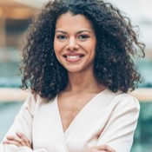


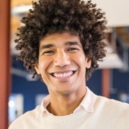

MEET CYBERQUAck
MICHAEL RODRIGUEZ
SAMANTHA LEE
RACHEL GREEN​
DANIEL KIM
Incident Response Manager - Lead
EDR Specialist
Technical Analyst
Technical Analyst
ISABELLA MARTINEZ
OLIVIA WILDE
LUCAS BROWN
DAVID SMITH
Certified Ethical Hacker - Lead
Compliance and Risk Manager
Security Engineer
Security Engineer

Slide 12
OUR COMPETITION
CYBERQUACK
COMPETITORS
Our product is priced below that of other companies on the market
Design is simple and easy to use, compared to the complex designs of the competitors
Affordability is the main draw for our consumers to our product
Company A Product is more expensive
Companies B & C Product is expensive and inconvenient to use
Companies D & E Product is affordable, but inconvenient to use

Slide 13
Market comparison
$3B
$2B
$1B
Opportunity to build
Freedom to invent
Few competitors
Addressable market
Serviceable market
Obtainable market

Slide 14
MARKET OVERVIEW
$3 Billion
$1 Billion
$2 Billion
Freedom to invent
Selectively inclusive market
Serviceable available market
Opportunity to build
Fully inclusive market
Total addressable market
Few competitors
Specifically targeted market
Serviceable obtainable market

Slide 15
SUMMARY
At Contoso, we believe in giving 110%. By using our next-generation data architecture, we help organizations virtually manage agile workflows. We thrive because of our market knowledge and great team behind our product. As our CEO says, "Efficiencies will come from proactively transforming how we do business.”

Slide 16
THANK YOU
Mirjam Nilsson​
206-555-0146
mirjam@contoso.com
www.contoso.com

